Slide 1

Reproducible Machine Learning The Team Data Science Process
Buck Woody
Applied Data Science
Microsoft Research and AI
Notes:
Description:
DevOps (Developer Operations) is defined as a development process that emphasizes communication and collaboration between product management, software development, and operations, automating the process of solution integration, testing, deployment and infrastructure changes.
All projects involving on-premises software and hardware benefits from DevOps. But hybrid and cloud-only architectures require it – there are so many variables to even setting up the architecture that a dedicated team or developer is often required. And Advanced Analytics projects involving Data Science have even more requirements that are specific to these tasks.
This course explains the processes, procedures, and platform options that you have available, along with explaining the tools you need to use to create an effective DevOps solution for your Advanced Analytics projects.
Level:
300
Audience:
Technical professionals tasked with the infrastructure and development of a DevOps practice for Advanced Analytics Projects.

Slide 2
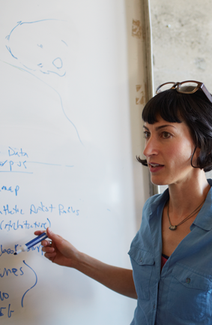
Learnings from Data Scientists
Teams are expanding, not always with Data Scientists as the only members
Data Scientists have followed the CRISP-DM in the past, or their own process
Integration into Agile, SDLC, DevOps and other frameworks can be problematic
Businesses expect Data Science projects to fall in line with corporate practices
Processes should have role guides and project plans

Slide 3
The Need for Process in Data Science
Monitor
Code
Test
Package
Deploy
Build
Configure
Use
AI / ML / DL
Notes:
The first thing to know is that organizations do not always consider a “Data Science” or AI project as a separate entity – they view it as a continuum in their data-as-asset strategy.

Slide 4
Reproducible Data Science
Notes:
Complete DevOps guide - https://docsmsftpdfs.blob.core.windows.net/guides/azure/azure-ops-guide.pdf
Azure Design Patterns: https://blogs.msdn.microsoft.com/uk_faculty_connection/2017/05/17/getting-started-with-azure-design-patterns-and-azure-arm-quick-start-templates/
Deployment
Service Creation and Setup - https://azure.microsoft.com/en-us/offers/ms-azr-0003p/
Cost Management (Pricing) - https://azure.microsoft.com/en-us/pricing/
Migrations - https://msdn.microsoft.com/en-us/library/dn727097.aspx
Tools
The Azure Portal - https://docs.microsoft.com/en-us/azure/azure-portal-overview
PowerShell - https://docs.microsoft.com/en-us/powershell/azure/overview?view=azurermps-3.8.0
CLI - https://docs.microsoft.com/en-us/cli/azure/install-azure-cli
Others - Visual Studio, System Center, Jenkins, chef
Azure Automation - https://azure.microsoft.com/en-us/services/automation/
Facilities and Regions
Locations - https://azure.microsoft.com/en-us/regions/
Security
Authentication and Access - https://docs.microsoft.com/en-us/azure/active-directory/connect/active-directory-aadconnect
Security best practices - https://docs.microsoft.com/en-us/azure/active-directory/role-based-access-control-configure
Azure Trust Center - https://azure.microsoft.com/en-us/support/trust-center/
Resource Grouping
Resource Groups - https://docs.microsoft.com/en-us/azure/azure-resource-manager/resource-group-overview
Using the ARM model - https://docs.microsoft.com/en-us/azure/azure-resource-manager/resource-group-template-deploy-portal
Safety - https://docs.microsoft.com/en-us/azure/storage/storage-redundancy
Auditing - https://msdn.microsoft.com/en-us/library/mt662411.aspx?f=255&MSPPError=-2147217396
Troubleshooting and Support - https://azure.microsoft.com/en-us/blog/understanding-azure-troubleshooting-and-support/
Top 10 resources to keep up to date with the Azure Platform - https://blogs.msdn.microsoft.com/bizspark_au/2017/07/07/top-10-resources-i-use-to-keep-up-to-date-with-new-innovations-on-the-azure-platform/
Special considerations for Advanced Analytics:
Account management
Storage and redundancy
Privacy and data protection
Scheduling and Pipelined workflows
Networking - https://www.simple-talk.com/cloud/cloud-data/azure-networking-sql-server-dbas/
Optimization
Security
Advanced Analytics Services awareness – data transfer, storage and processing
Dependencies and interactions

Slide 5
Process Advantages
Standardization (Repeatability)
Communication
Shared Development
Security
Encapsulation
Notes:
Start with a view of the project to start the discussion - https://buckwoody.wordpress.com/2017/08/17/a-data-science-microsoft-project-template-you-can-use-in-your-solutions/
Account management is something that will often be new to the Data Science Team – https://docs.microsoft.com/en-us/azure/billing/billing-getting-started
Setting up the Azure Environment, particularly working with the Azure Resource Model and deployment slots, is important to consider at the outset – https://azure.microsoft.com/en-us/resources/videos/resource-group-model-modern-management-for-modern-cloud/
Development should break out of silos, so DevOps CI/CT/CD should be integrated early – https://docs.microsoft.com/en-us/aspnet/aspnet/overview/developing-apps-with-windows-azure/building-real-world-cloud-apps-with-windows-azure/continuous-integration-and-continuous-delivery
It’s important to consider the end-to-end experience, as this affects everything from security to design – https://gallery.cortanaintelligence.com/Tutorial/Create-an-End-to-End-E2E-Deployment-ready-Data-Pipeline-for-Consuming-Azure-Services-A-Step-by-Step-Guide-2
There is often an established Build/Test environment in the organization that may include CI/CT/CD – these need to be considered early (shift-left) – https://msdn.microsoft.com/en-us/library/dn449957.aspx
Data is important, and a full scrub for PII and other sensitivities are very important to the Data Science project - https://msdn.microsoft.com/en-us/magazine/ee291586.aspx

Slide 6
The Team Data Science Process
Business Understanding
Define Objectives
Identify Data Sources
Data Acquisition and Understanding
Ingest Data
Explore Data
Update Data
Modeling
Feature Selection
Create and Train Model
Deployment
Operationalize
Customer Acceptance
Testing and Validation
Handoff
Re-train and re-score
http://aka.ms/tdsp
Notes:
It also references the Cortana Intelligence process - https://azure.microsoft.com/en-us/documentation/articles/data-science-process-overview/
A complete process diagram is here - https://azure.microsoft.com/en-us/documentation/learning-paths/cortana-analytics-process/
Some walk-throughs of the various services - https://azure.microsoft.com/en-us/documentation/articles/data-science-process-walkthroughs/
An integrated process and toolset allows for a more close-to-intent deployment
Iterations are required to close in on the solution – but are harder to manage and monitor
Data Science Blog - https://buckwoody.wordpress.com/

Slide 7
Process Advantages
Communication
Business Understanding
Define Objectives
Identify Data Sources
Data Acquisition and Understanding
Ingest Data
Explore Data
Modeling
Feature Selection
Create and Train Model
Deployment
Customer Acceptance
Operationalize
Testing and Validation
Update Data
Handoff
Re-train and re-score
Notes:
Working in a team means “shifting left” – a new concept for many technologists - https://www.cio.com/article/3050579/leadership-management/want-agile-devops-shift-left.html

Slide 8
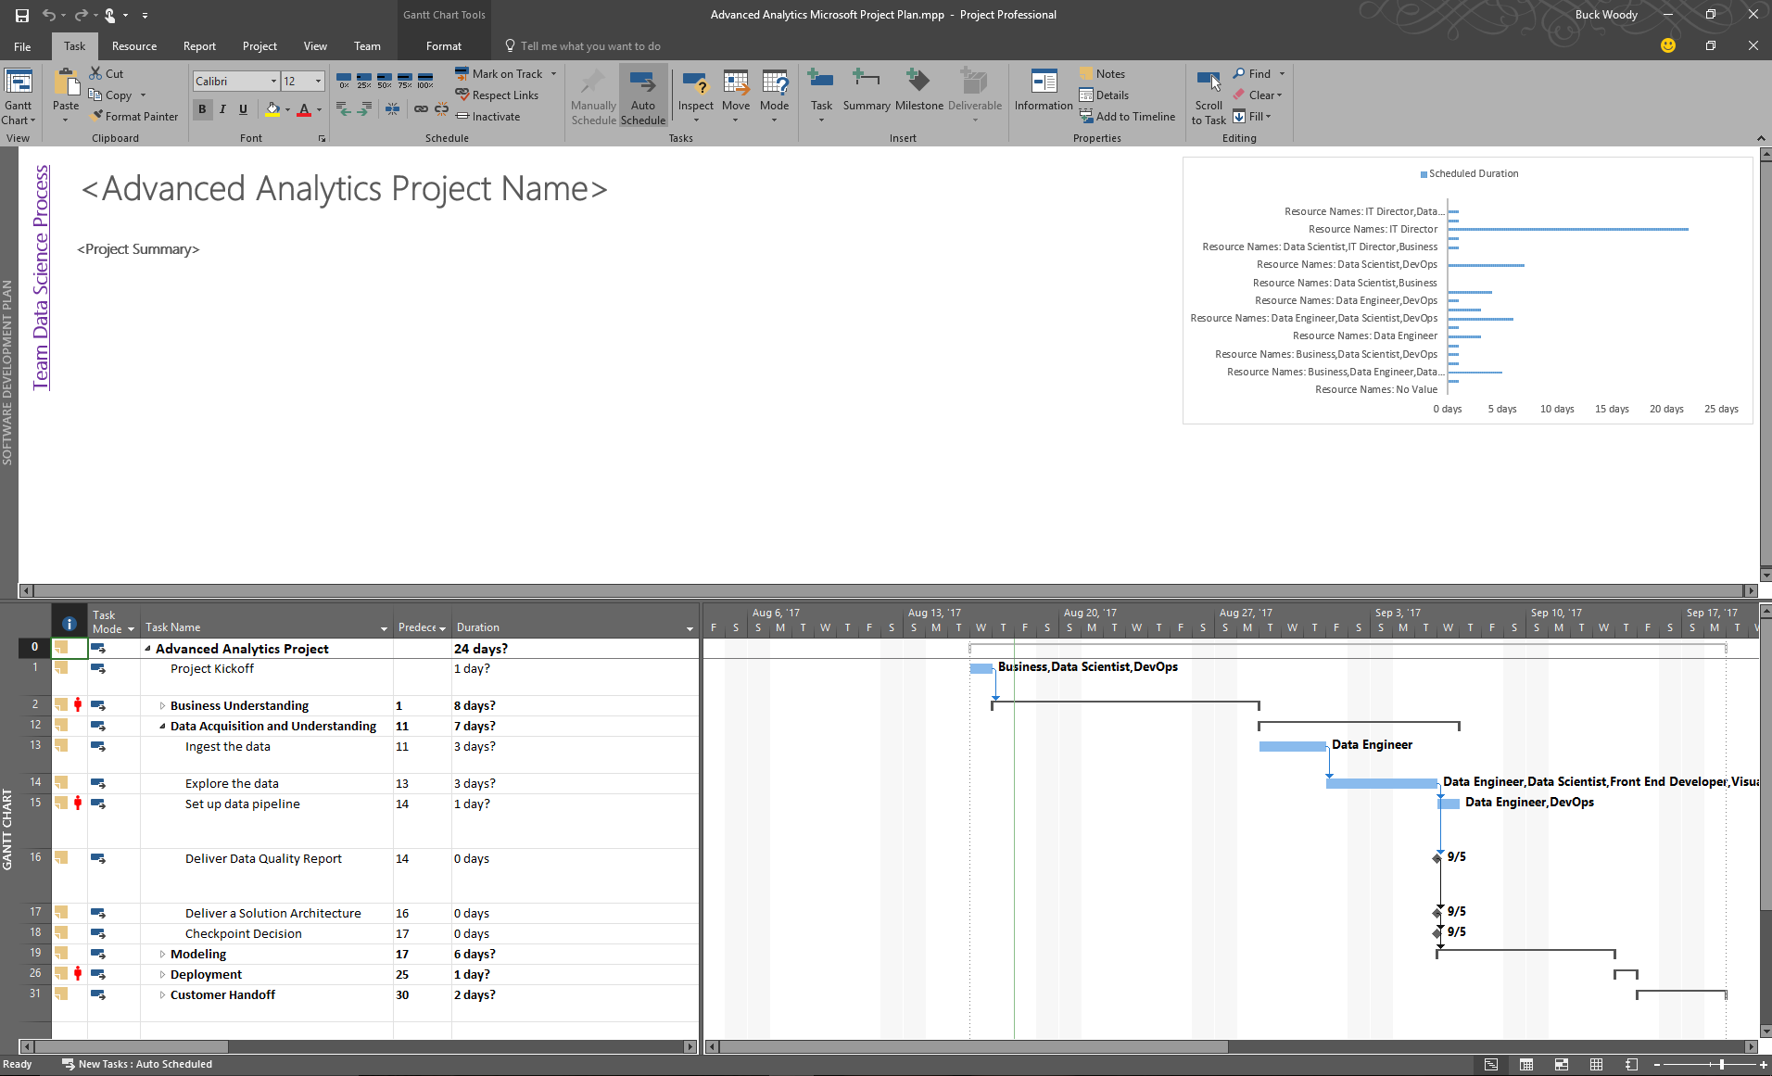
The Data Science/DevOps Difference - Communication
Participating in a Project Framework
Notes:
Working with Microsoft Project in Solutions: https://buckwoody.wordpress.com/2017/08/17/a-data-science-microsoft-project-template-you-can-use-in-your-solutions/
Synchronizing your TFS with MPS - https://www.visualstudio.com/en-us/docs/work/office/sync-ps-tfs

Slide 9
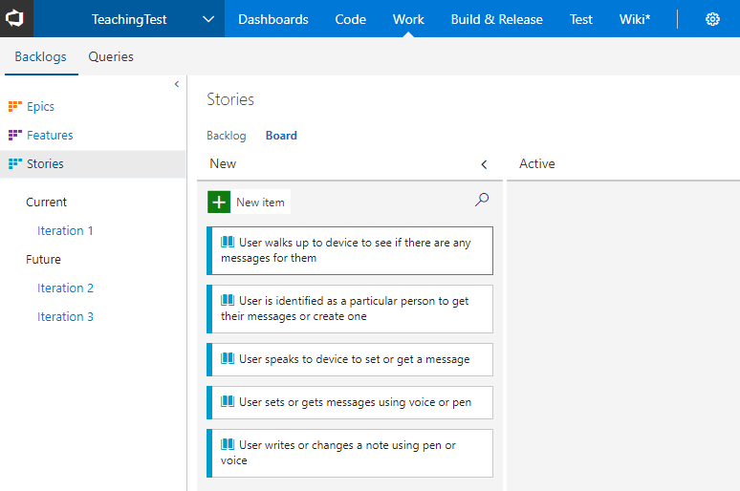
The Data Science/DevOps Difference – Communication
Devs – Stories and Features
Notes:
Analyze and Model your architecture in Visual Studio - https://msdn.microsoft.com/library/57b85fsc%28v=vs.140%29.aspx
Video – capture business workflows - http://channel9.msdn.com/posts/clinted/uml-with-vs-2010-part-4-capture-business-workflows/
Video – Improve architecture through modeling - http://go.microsoft.com/fwlink/?LinkID=252078
Creating your backlog - https://www.visualstudio.com/en-us/docs/work/backlogs/create-your-backlog

Slide 10


Data Science – Problem to Data Flow
The Data Science/DevOps Difference - Communication
Determine the Question
Document the Data
Diagram the Data Flow
Notes:
PowerPoint, Visio, Whiteboard – choose a visualization declaration mechanism, make it part of your check in. Make sure you treat infrastructure and code as a single thought-entity. - https://www.visualstudio.com/en-us/docs/work/office/storyboard-your-ideas-using-powerpoint
Using a holistic approach: https://www.linkedin.com/pulse/architecture-data-exploration-using-microsoft-azure-verdon-mba
Planning a Big Data solution: https://msdn.microsoft.com/en-us/library/dn749858.aspx

Slide 11
Decision Matrix
Decision | Technology | Elements | Rationale
Large amounts of semi-structured data | Azure Tables | Scale, KVP, Multi-access | Can be used by multiple technologies or queried
Fast, multiple sources of data | Event Hubs, Stream Analytics | Speed, complex processing | Fast Ingestion of massive datasets
Anomaly detection | Azure ML | API-Driven detection | Built-in algorithms, multi-dev
Reporting | SQL DB, Power BI | Ease of reporting, data visualization | Standard queries, action-based visualizations
System monitoring and management | Azure Data Factory, Application Insights | Actionable system metrics | OOB orchestration and reporting
Notes:
Another approach on decision matrices: http://www.businessnewsdaily.com/6146-decision-matrix.html

Slide 12
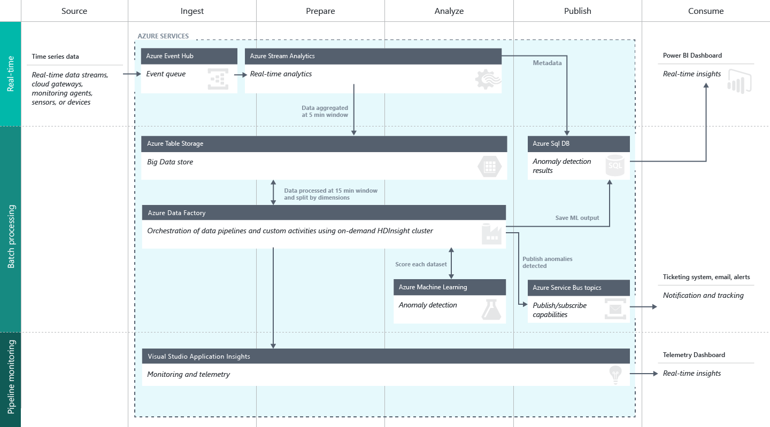
The Data Science/DevOps Difference - Communication
Create a Data Flow
Notes:
Full description is here: https://github.com/Azure/itanomalyinsights-cortana-intelligence-preconfigured-solution/blob/master/Docs/IT%20Anomaly%20Insights%20Post%20Deployment%20Instructions.md
Create your own Solution Templates: https://start.cortanaintelligence.com/CustomSolutions
More solution tutorials: https://gallery.cortanaintelligence.com/browse?categories=%5B%227%22%5D&skip=0&orderby=trending%20desc&tags=%5B%22Solution%22%5D
https://microsoft.github.io/techcasestudies/#sortBy=featured&SearchPhraseText=devops
https://microsoft.github.io/techcasestudies/#sortBy=featured&SearchPhraseText=vsm

Slide 13
Process Advantages
Security and Compliance
Business Understanding
Define Objectives
Identify Data Sources
Data Acquisition and Understanding
Ingest Data
Explore Data
Modeling
Feature Selection
Create and Train Model
Deployment
Customer Acceptance
Operationalize
Testing and Validation
Update Data
Handoff
Re-train and re-score
Notes:
Understanding the Azure Portal for management and billing - https://azure.microsoft.com/en-us/account/

Slide 14
The Data Science/DevOps Difference
Shared Development
Business Understanding
Define Objectives
Identify Data Sources
Data Acquisition and Understanding
Ingest Data
Explore Data
Modeling
Feature Selection
Create and Train Model
Deployment
Customer Acceptance
Operationalize
Testing and Validation
Update Data
Handoff
Re-train and re-score
Notes:
Working effectively in teams - https://www.svds.com/working-effectively-in-data-science-teams/

Slide 15
The Data Science/DevOps Difference
Data Flow
Business Understanding
Define Objectives
Identify Data Sources
Data Acquisition and Understanding
Ingest Data
Explore Data
Modeling
Feature Selection
Create and Train Model
Deployment
Customer Acceptance
Operationalize
Testing and Validation
Update Data
Handoff
Re-train and re-score
Notes:
Without a good data flow design, your project may not go into production - https://medium.com/towards-data-science/how-to-build-a-data-science-pipeline-f24341848045

Slide 16
The Data Science/DevOps Difference
Build and Test
Business Understanding
Define Objectives
Identify Data Sources
Data Acquisition and Understanding
Ingest Data
Explore Data
Modeling
Feature Selection
Create and Train Model
Deployment
Customer Acceptance
Operationalize
Testing and Validation
Update Data
Handoff
Re-train and re-score
Notes:
Assets within a Data Science project may contain multiple artifacts. For the most part, an Azure Resource Manager template can contain most of these - https://docs.microsoft.com/en-us/azure/azure-resource-manager/resource-group-template-deploy-portal

Slide 17
The Data Science/DevOps Difference
Security
Business Understanding
Define Objectives
Identify Data Sources
Data Acquisition and Understanding
Ingest Data
Explore Data
Modeling
Feature Selection
Create and Train Model
Deployment
Customer Acceptance
Operationalize
Testing and Validation
Update Data
Handoff
Re-train and re-score
Notes:
The Azure Trust Center (Security, Privacy, Transparency, Compliance) - https://azure.microsoft.com/en-us/support/trust-center/
Working with the Azure Key Vault - https://blogs.msdn.microsoft.com/troy_aults_blog/2017/08/29/utilizing-key-vault-to-create-credentials-for-automation/

Slide 18
The Data Science/DevOps Difference
Monitoring
Business Understanding
Define Objectives
Identify Data Sources
Data Acquisition and Understanding
Ingest Data
Explore Data
Modeling
Feature Selection
Create and Train Model
Deployment
Customer Acceptance
Operationalize
Testing and Validation
Update Data
Handoff
Re-train and re-score
Notes:
There is a great deal more information and many other tools to learn – all depend on your implementation

Slide 19
https://aka.ms/tdsp

